Slide 1
EAGLE CAD & PCB Design
Henry Kou and Evan Brown

Slide 2
Downloads
Eagle: https://www.autodesk.com/products/eagle/free-download
Libraries: https://goo.gl/qxKHZW
Add these libraries to the lbr folder of Eagle (after you download it)
For Windows --> C:\EAGLE {$version_num}\lbr
For Mac -->$EAGLEDIR/lbr

Slide 3

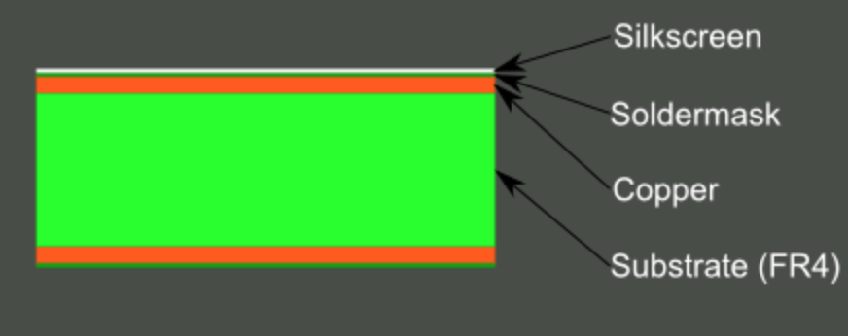
What is a PCB?
PCB is an acronym for printed circuit board.
It is a board that has traces that electrically connect the various connectors and components to each other.
Organized in layers

Slide 4
What is EAGLE?
Software for PCB Design. Allows you to create a software model of your PCB so it can be manufactured.

